Slide 1
클라우드 기반 빅데이터 환경구축: 빅데이터 분석 및 머신러닝 환경 개요
전병곤
서울대학교 컴퓨터공학부

Slide 2
Course Goal
본 과목에서는 아마존 웹 서비스와 같은 클라우드 환경에서 데이터 분석 파이프라인을 구축하여 다양한 데이터 분석 (배치, 스트림, 인터액티브 질의, 머신러닝/딥러닝)을 수행하는 시스템을 배우고 분석에 적용해 본다.

Slide 3
Course Content
빅데이터 분석 및 머신러닝 환경 개요 및 클라우드 환경 셋업
배치 처리 분석
대화형 질의 분석
스트림 처리 분석
기계학습 분석
딥러닝 분석

Slide 4
Course Logistics
Lectures (Theory + Practice Session)
3 Homeworks
Homework 1: Batch, SQL
Homework 2: Stream, (Machine learning)
Homework 3: Deep learning
2 Exams
Cloud for homeworks, practice sessions
AWS credit: $300 per team

Slide 5
빅데이터 분석 및 머신러닝 클라우드 (데이터센터) 환경

Slide 6
Server Machine
http://opencompute.org/products/olympus-1u-server/

Slide 7
Software running on a server machine
Operating systems
Isolation
Multiplexing of resources
Data sharing
Programming abstractions
Application software

Slide 8
Datacenter is the new computer
https://blog.google/topics/google-asia/growing-our-data-center-in-singapore/

Slide 9
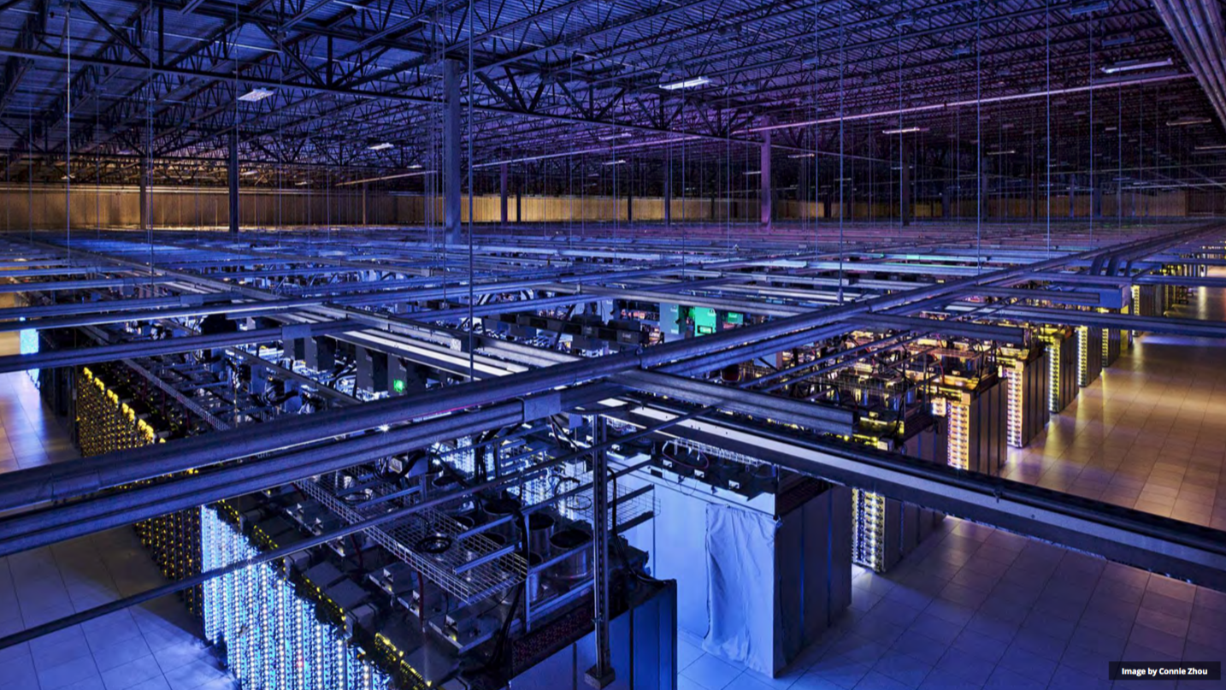
Datacenter

Slide 10
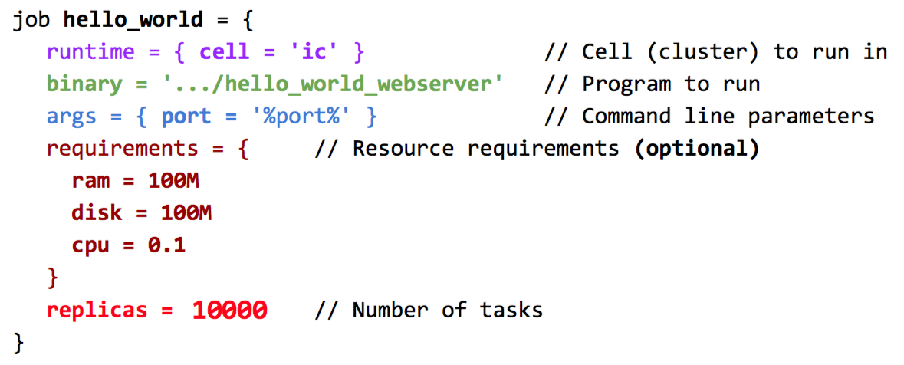
Datacenter job
(Borg, EuroSys 2015)

Slide 11
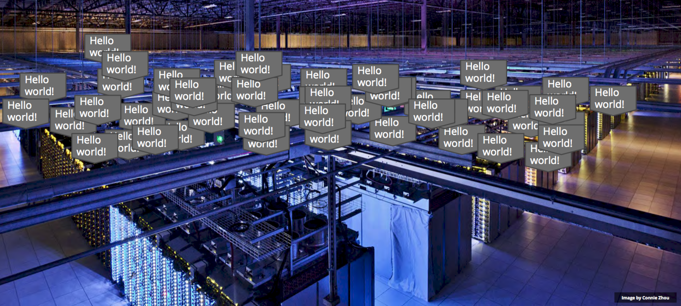
Datacenter job running

Slide 12
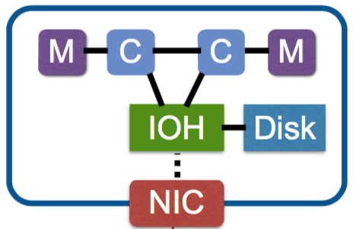
Datacenter structure
(Server image: Gao et al., OSDI 2016)
More cores
More memory
More storage
More network bandwidth
Network topology
Tree -> FatTree, Clos
Cross datacenter
Disaggregation

Slide 13
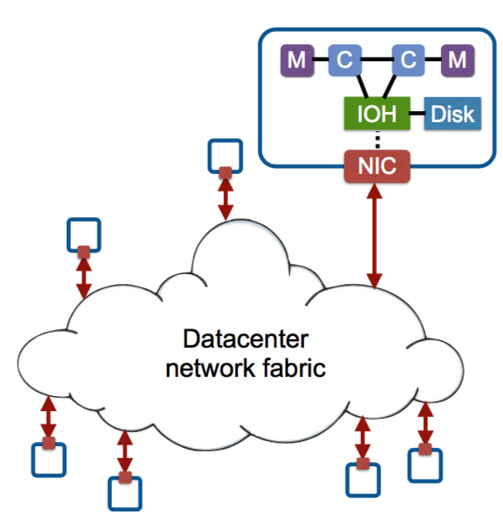
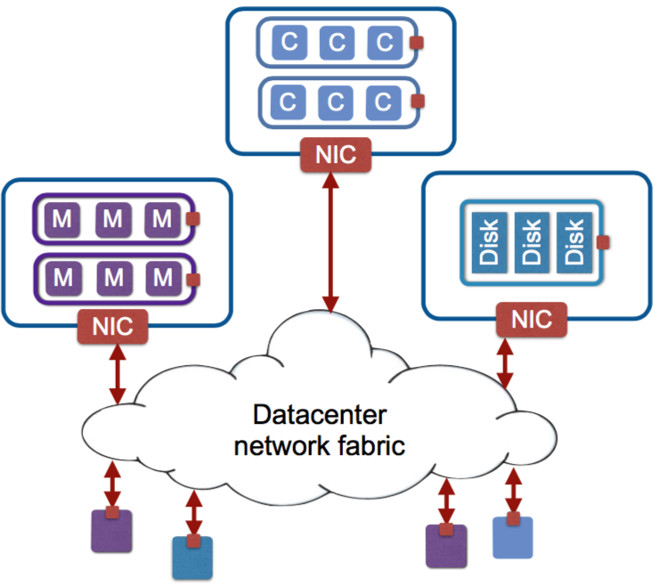
Disaggregated datacenters
Rack-scale disaggregation, datacenter-scale disaggregation
(Gao et al., OSDI 2016)
Server-centric datacenter
Resource-centric datacenter
*Deployment example: Facebook’s disaggregated storage and compute
Notes:
Tightly couple a“pool of resources”(CPU, memory,disk)
Interconnects a“pool of servers”
Interconnects a“pool of resources”

Slide 14
Software running on a datacenter
Application-level software
Cluster-level infrastructure software
Server-level software
* Default: no virtualization
(Virtualization for public cloud offerings)

Slide 15
Software running on a datacenter
Applications
(Email, Search, Social media, Mobile apps, …)
resource
files, dirs
put, get
acquire, release
tasks
enq, deq
Cluster-level infrastructure software
Resource
manager (Borg, YARN, Mesos)
Distributed file system (GFS, HDFS, NFS)
Key/value store
(Dynamo, Cassandra)
Distributed locking system (Chubby, Zookeeper)
Distributed computing (MapReduce,Spark)
Message queues
(Kafka, ActiveMQ)
TCP, UDP, HTTP, … (low-level comm. interfaces)
Notes:
Distributed systems raise the level of abstraction
Hide many complexities and make it easier to build applications

Slide 16
















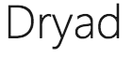
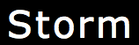













Software running on a datacenter

Slide 17
Datacenter software vs. server software
Ample parallelism
Workload churn
Platform homogeneity
Faults are part of daily life
Notes:
Data parallel, request parallel

Slide 18
Datacenter metrics
Performance - latency, throughput
Availability/durability
Consistency
Scalability
Resource utilization

Slide 19
Datacenter software performance and availability toolbox
Replication - performance and availability
Erasure codes - availability and space savings
Sharding - performance and availability, scalability
Load-balancing – performance
Health monitoring – availability
Integrity checks – availability
Less strict consistency - performance and availability
Centralized control – performance
Canaries – availability
Redundant execution and tail-tolerance - performance

Slide 20
Cluster-level infrastructure software
Resource manager
Basic services - distributed file systems, locking, key-value store
Deployment and maintenance
Programming frameworks

Slide 21
Two types of application services
Online serving systems - search, office, social media, video, ML inference, ...
Tail latency
Offline analytics - search indexing, data processing, ML training, ...
Throughput

Slide 22
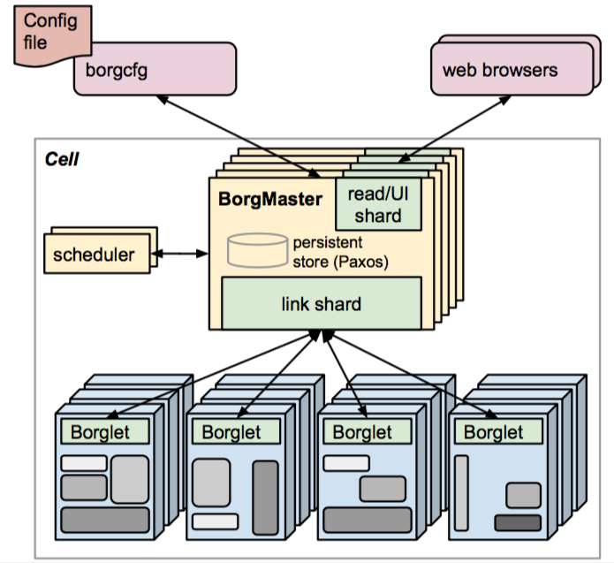
Resource manager
Manage allocation of containers
Container
A logical bundle of resources (e.g., <2GB RAM, 1 CPU core>) bound to a particular node
Locality: node-local, rack-local, any Scheduling constraints
(Borg, EuroSys 2015)
Notes:
Virtual machine x

Slide 23
Distributed key value store, file system
Dynamo Serving workloads Relational Model, Transaction (X) => Key, Value Access (O)
GFS Traditional file system workloads (mix of read/write) (X) => Data processing workloads (streaming read of large data, append) (O)

Slide 24
Distributed key value store, file system
Dynamo ACID (distributed) database => distributed key-value store (cross DC)
GFS Posix-compliant (distributed) file system => distributed file system for data processing (within a DC)

Slide 25
High-level view of serving and analytics
Online serving
Offline analytics
User-facing Service
Data analytics
pipeline
ML workflow (training)
ML prediction

Slide 26
Serving systems
Caching servers (memcached, …)
Web servers
Application servers (django, nodejs, …)
Database servers (mysql, nosql, …)

Slide 27
Web search example
Cache
Searching indexes Ranking
Web frontend
Aggregator

Slide 28
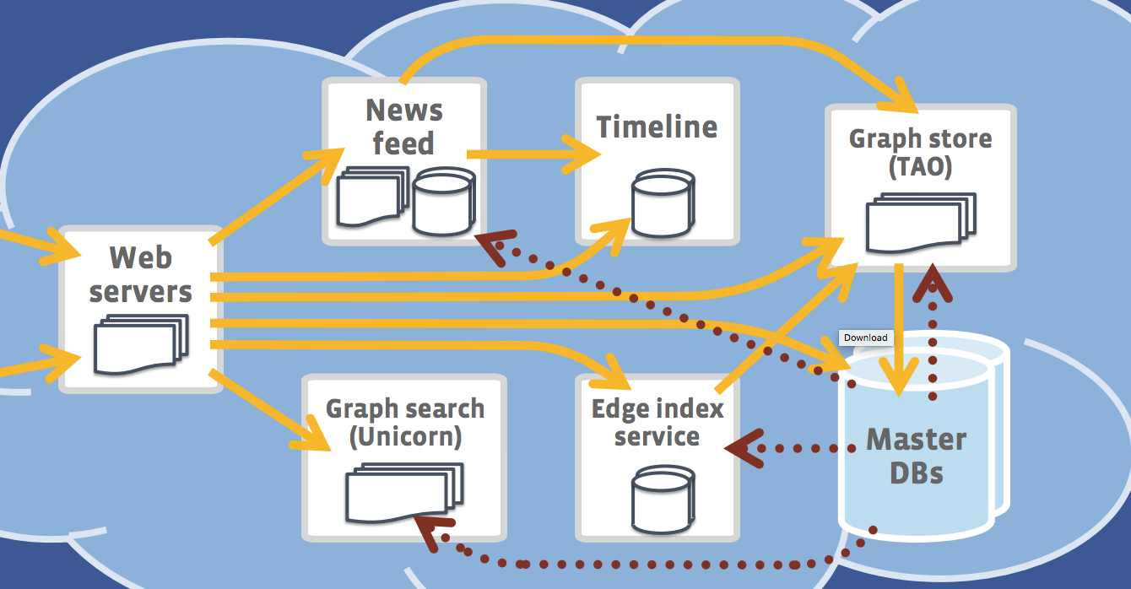
Facebook web service

Slide 29
Data analytics
Batch
Processing
Stream
Processing
Interactive
Query
Machine
Learning
Graph
Processing
Resource Manager
Distributed File System

Slide 30
Spark big data stack
Spark SQL
Spark Streaming
MLlib
(Machine
Learning)
GraphX
(Graph Processing)
Spark Core
Standalone Scheduler
YARN
Mesos

Slide 31
Brief history of data analytics
Apache Beam
(2016)
Google MapReduce (OSDI 2004)
Apache Hadoop
(2006)
Apache
HBase
(2007)
Google Tensorflow
(2015)
Facebook Caffe2
(2017)
FlumeJava
(2010)
Spark
(2011)
Google GFS (SOSP 2003)
Google BigTable (OSDI 2006)
YARN/ Mesos
(2011)
Apache Tez
(2015)
Apache
PyTorch
(2016)
Apache MXNet
(2017)

Slide 32
Dataflow systems
Dataflow graph: a directed acyclic graph of operators
Create 1st Model
Compute Gradient
Aggr
Gradient
Compute 2nd Model
....
Read Training Data

Slide 33
Map Reduce: Programming
map
reduce
map: [k1, v1]’s -> [k2, v2]’s
reduce [k2, v2]’s -> [k3, v3]’s
Word count problem: how many times different words appear in data
Python: lambda a, b: a + b
Python: lambda word: (word, 1)

Slide 34
Map Reduce: Physical Plan
A task is an instance of an operator.
Input data partition1
map task
shuffle
Output data partition1
reduce
task
Input data partition2
map task
Output data partition2
reduce
task
Input data partition3
map
task
A large job has tens of thousands of tasks!

Slide 35
MapReduce WordCount Physical Execution
Split
Map
Shuffle
Reduce
(Apple,1)
(Apple,1) (Apple,1) (Apple,1)
(Apple,1)
(Pear,1)
(Orange,1)
Apple Pear Orange
(Apple,4)
Apple Pear Orange
(Orange,1)
(Grapes,1)
Orange Grapes
Orange Grapes
(Grapes,1)
(Mango,1) (Mango,1)
(Grapes,1)
(Mango,2)
Apple Mango Pear
Apple Apple Mango
(Apple,1)
(Mango,1)
(Pear,1)
Apple Mango Pear
(Orange,1)
(Orange,1) (Pear,1)
(Pear,1)
(Orange,2)
(Pear,2)
(Apple,1)
(Apple,1)
(Mango,1)
Apple Apple Mango

Slide 36
Map Reduce runtime handles scheduling, fault tolerance, scalability, elasticity
reduce
map
reduce
map
reduce
map
reduce
map
reduce
map
reduce
map
reduce
map
reduce
map
reduce
map
reduce
map
reduce
map
reduce
map
reduce
map
reduce
map
reduce
map
reduce
map
reduce
map
reduce
map
reduce
task
map
map
map
map
map
map
map
map
map
map
map task
Notes:
Limited programming flexibility
In particular, inefficient for multi-pass algorithms
No efficient primitives for data sharing
State between MapReduce passes goes through distributed file systems

Slide 37
Spark
http://blog.cloudera.com/blog/2013/11/putting-spark-to-use-fast-in-memory-computing-for-your-big-data-applications/
* Spark performance (Making sense of performance in data analytics frameworks, NSDI 2015)
Notes:
RDD: a collection of datasets
Interactive Data Analysis

Slide 38
How much faster could jobs get from optimizing network performance? (NSDI 2015)
Percentiles
95
75
50
25
5
Median improvement at most 2%

Slide 39
How much faster could jobs get from optimizing disk performance? (NSDI 2015)
Median improvement at most 19%
For in-memory workloads, median improvement 2-5%
Notes:
Even in-memory workloads store shuffle data on disk.
Respectable improvement, but is lower than we expected for workloads that read input data and store output data on-disk. Let’s make more sense of this number, first by considering the hardware setup, and then by examining alternate metrics to put this number in the context of how tasks spend their time.
Includes disk reading input data, reading/writing intermediate (shuffle) data from disk, writing output data
Highest median: 23%!
Includes all disk and network (impossible to separate these)
Caps improvement from flash etc.

Slide 40


Spark performance (NSDI 2015)
up to 10x
spark.apache.org
19%
(Ousterhout et al.,
NSDI 2015)
6x or more
amplab.cs.berkeley.edu/benchmark/
serialized + compressed on-disk
data
serialized + compressed in-memory data
deserialized in-memory data
(on-disk data)
Faster
* Batch, SQL workload

Slide 41

Apache Nemo: A New Flexible Data Processing Framework (SNU SPL)
Apache Incubation: Feb. 4, 2018
https://nemo.apache.org
.map(…)
.reduce(…)
User
application
Optimization
policy
Optimization pass:
IR → IR’
Compiler
Frontend
Optimizer
Mentors from Google, Microsoft,
Databricks,
Talend,
Coupang
Backend
Intermediate
representation (IR)
Optimized IR
Runtime
Master
Executor
Backbone
Backbone
Modules
Modules

Slide 42
Datacenter for AI
Facebook AI
“FBLearner Flow is used by more than 25 percent of Facebook's engineering team. Since its inception, more than a million models have been trained, and our prediction service has grown to make more than 6 million predictions per second.” (May 10, 2016)
“Depending on the product, the online inference phase may be run tens-of-trillions of times per day.” (HPCA 2018)

Slide 43
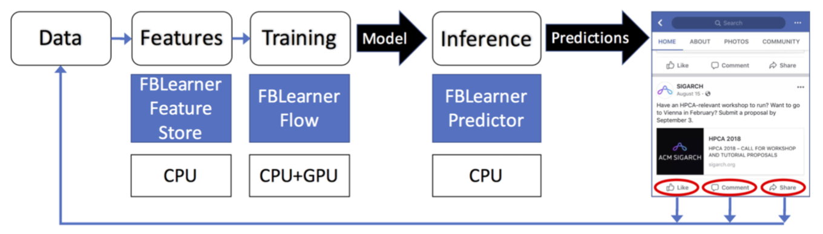
Facebook’s machine learning flow and infrastructure (Facebook, HPCA 2018)

Slide 44
Datacenter for AI: a Server with GPUs
https://code.facebook.com/posts/1835166200089399/introducing-big-basin-our-next-generation-ai-hardware/
Notes:
volta

Slide 45
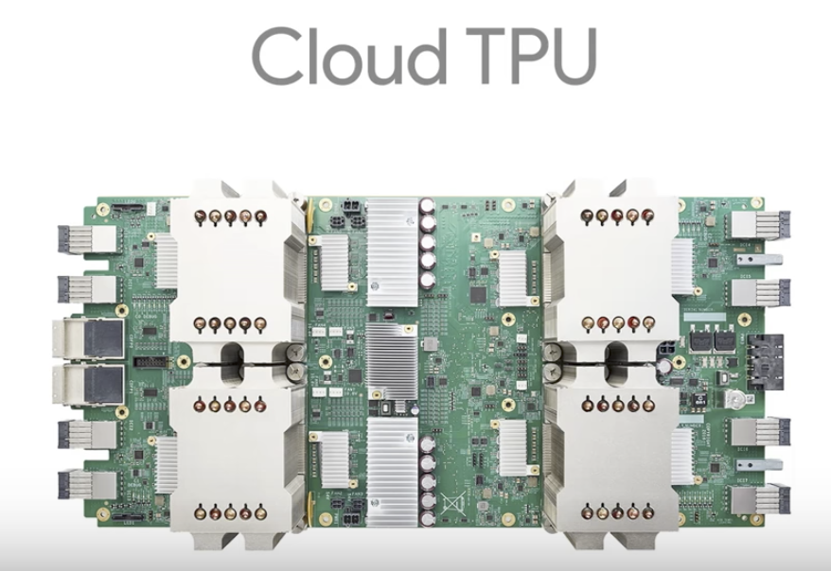
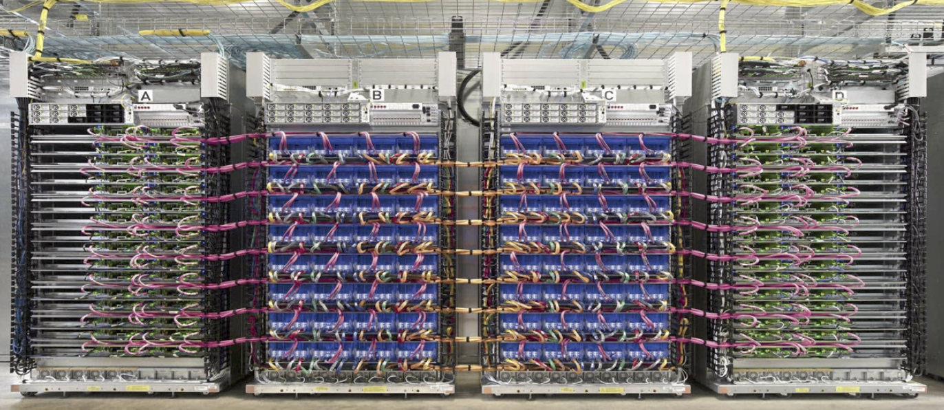
AI-Optimized HW
A TPU Pod Includes 64 Cloud TPU Boards
180 TFLOPS
11.52 PFLOPS
Notes:
Intel 18 core i9 ($2000) – 1TFlops

Slide 46
Datacenter for AI
High-speed networking: RDMA over Ethernet/Infiniband
Server
GPUs
Distributed AI example: Facebook used 256 GPUs to train ImageNet in 1 hour (CVPR 2017)
Medium-to-small scale

Slide 47
AI frameworks
Training: high throughput
Parallelism: data parallelism, model parallelism
Synchronization: synchronous, asynchronous
Synchronization architecture: parameter server, MPI
Inference: low latency

Slide 48
AI frameworks
Define-and-run
(Tensorflow, Caffe2, MxNet)
Create a computation graph
Execute the graph
Define-by-run
(PyTorch)

Slide 49
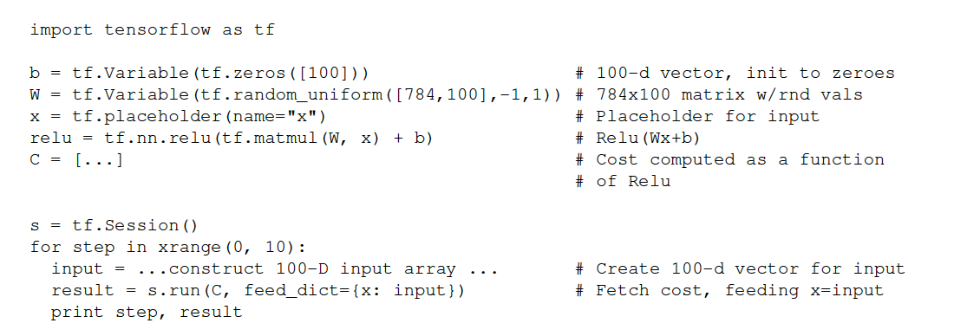
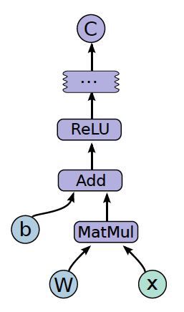
AI framework example: Tensorflow
Computation as a graph
(Abadi et al., 2015)

Slide 50
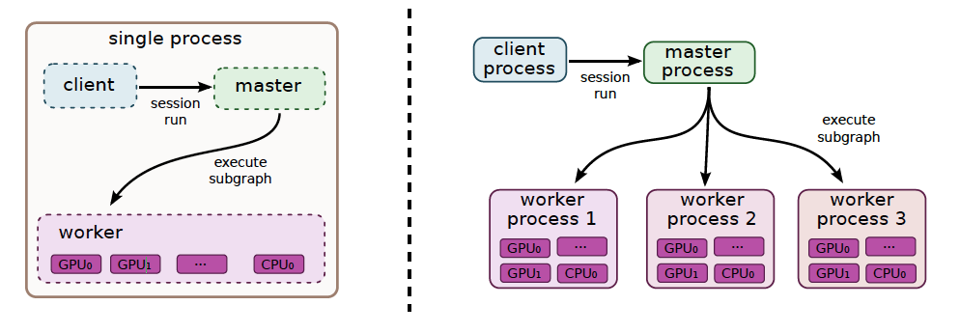
AI framework example: Tensorflow
(Abadi et al., 2015)

Slide 51
Cloud 환경

Slide 52
Emulating an Internal Cluster in a Public Cloud
Likely to build your own internal cluster if you can’t put your data on a public cloud like Amazon Web Service, Microsoft Azure, Google Cloud
We emulate an internal cluster in a public cloud

Slide 55
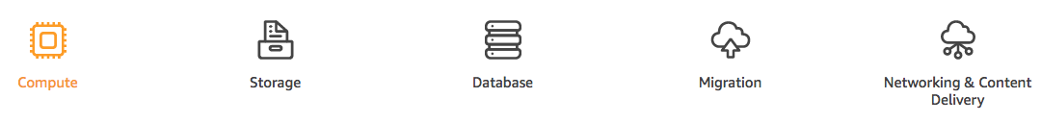
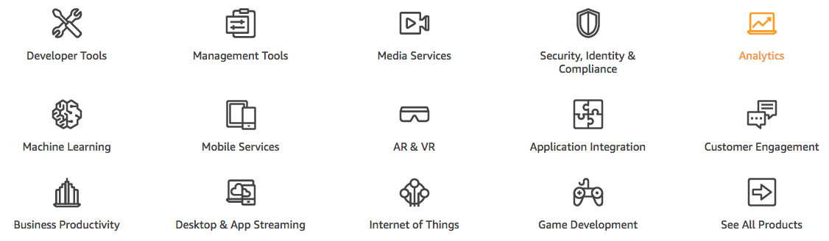
Amazon Web Service (AWS)
(Ref. https://aws.amazon.com/)

Slide 56
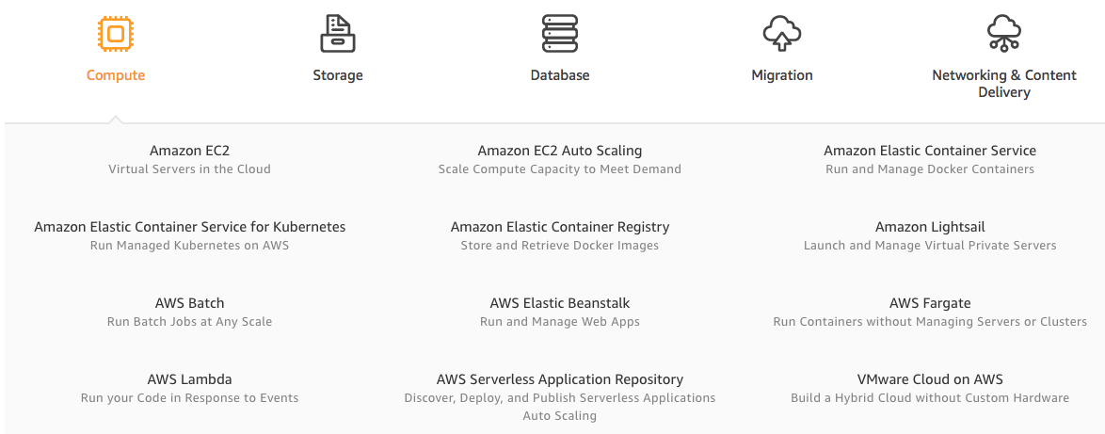
Amazon Web Service (AWS)
(Ref. https://aws.amazon.com/)

Slide 57
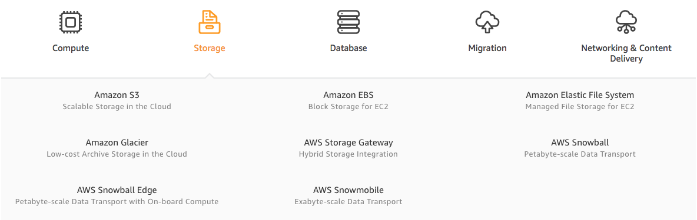
Amazon Web Service (AWS)
(Ref. https://aws.amazon.com/)

Slide 58
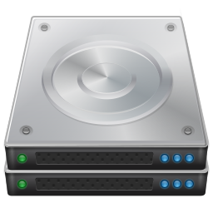
Private Cluster Setup (Co-located Compute and Long-term Storage)
C
S
C
S
C
S
C
S
C
S
C
S
C
S
C
S
C
S
C
S
C
S
C
S
C
S
C
S
C
S
C
S
C
S
C
S
C
S
C
S

Slide 59
Amazon Infrastructure Setup
EC2
S3
Rent VMs When you terminate VMs, the storage associated with the VMs gets destroyed
Long-term storage

Slide 60
Amazon EC2
Select a pre-configured, templated Amazon Machine Image (AMI) to get up and running immediately. Or create an AMI containing your applications, libraries, data, and associated configuration settings.
Configure security and network access on your Amazon EC2 instance.
Choose which instance type(s) you want, then start, terminate, and monitor as many instances of your AMI as needed, using the web service APIs or the variety of management tools provided.
Determine whether you want to run in multiple locations, utilize static IP endpoints, or attach persistent block storage to your instances.
Pay only for the resources that you actually consume, like instance-hours or data transfer.

Slide 61
Amazon S3
Object storage built to store and retrieve any amount of data from anywhere – web sites and mobile apps, corporate applications, and data from IoT sensors or devices.
Designed to deliver 99.999999999% durability

Slide 62
Amazon Infrastructure Setup
EC2
S3
Hadoop YARN, HDFS
Spark
TensorFlow
Store data input Store processing output

Slide 63
Big Data Problem
Data growing faster than processing speeds
The solution is to parallelize on large clusters
How do we program and run these things?

Slide 64
3Vs of Big Data
Variety: complex data
Unstructured text data, graph, audio, image, video
Volume: Lots of Data
Analytics at Scale
Velocity: Speedy data processing
Notes:
Predicting behavior

Slide 65
Real-world Use Cases 1. Risk Modeling
Risk modeling: how can banks better understand customers and markets?
Challenge: analyze customer activity across multiple products (in silos) to predict credit risk
Solution: set up a single BD cluster with multiple enterprise data warehouses, new sources of data including customer call center recordings, chat sessions, emails between service desk and others. Apply text processing, sentiment analysis, graph analysis, and pattern matching.
(ref. Cloudera whitepaper)

Slide 66
Real-world Use Cases 2. Customer Churn Analysis
Customer churn analysis: why do companies really lose customers?
Challenge: a large mobile carrier needed to analyze multiple data sources (call logs and other data) to understand how and why customers decided to terminate their service contracts
Solution:
Combine traditional call logs with social network data. If people in the customer’s social network were leaving, then the customer was more likely to depart.
Combine coverage maps with customer account data and could see how gaps in coverage affected churn.
And much more.
(ref. Cloudera whitepaper)

Slide 67
Real-world Use Cases 3. Recommendation Engine
Recommendation engine: how can companies predict customer preferences?
Challenge: the social dating company’s custom-built early system could not scale up as the customer base grew
Solution: use BD systems to run collaborative filtering with user preferences (user behavior on the web site (what profiles a customer visits, how long she looks at a particular page)) with compatibility models.
(ref. Cloudera whitepaper)

Slide 68
Real-world Use Cases 3. Recommendation Engine
Making content-to-human matches
Content publisher and aggregator: personalized content recommendations
Retailers, manufacturers: product recommendation
Social networking: “people you may know”
(ref. Cloudera whitepaper)

Slide 69
Real-world Use Cases 4. Ad Targeting
Ad targeting: how can companies increase campaign efficiency?
Challenge: selects ads best suited to a particular visitor with a twist: each advertiser is willing to pay a certain amount to have its ad seen. Ad networks auction ad space and advertisers want their ads shown to the people who most likely to buy their products. This is a complex optimization problem.
Solution: uses BD to build the model that uses large amounts of historical data on user behavior to cluster ads and users and to deduce preferences. Decide how successful the system has been at displaying ads that appealed to users. Choose the right ad for a given visitor in real time.
(ref. Cloudera whitepaper)
Notes:
Relevance of a given advertisement to a particular user, and the collection of bids by different advertisers who want to reach that visitor.

Slide 70
Real-world Use Cases 5. Point-of-sale Transaction Analysis
Point-of-sale transaction analysis: how do retailers target promotions guaranteed to make you buy?
Challenge: use collected customer data in stores and online and run sentiment analysis, NLP, etc.
Solution: loaded 20 years of sales transactions history into a cluster and used Hive (BD SQL) to perform the large-scale analysis
(ref. Cloudera whitepaper)

Slide 71
More Real-world Use Cases
6. Analyzing network data to predict failure: how can organizations use machine generated data to identify potential trouble?
7. Threat analysis: how can companies detect threats and fraudulent activity?
8. Trade surveillance: how can a bank spot the rogue trader?
9. Search quality: what’s in your search?
10. Data sandbox: what can you do with new data?
(ref. Cloudera whitepaper)
Notes:
6. Power company watches the performance of individual generators, looking for fluctuations that might suggest trouble. Sensor-data. Data center monitoring.
9. search: for the retailers revenue depends heavily on delivering search results that appeal to the user. The result depend on the content and on who the user is and what

Slide 72
Big Data Analytics Systems from 10,000 Feet
Distributed computing
Distributed storage
Resource management

Slide 73
Big Data and Machine Learning Categories
Batch processing
Stream processing
Interactive query
Graph processing
Machine learning / deep learning

Slide 74
Systems Related to Data Processing / Machine Learning
Load data
Store/manage data: file system, data stores
Manage resources
Meta-framework
Process data
High-level programming layer
Coordinate services
Manage workflows

Slide 75
Systems Related to Data Processing / Machine Learning
Load data – Flume, Sqoop, Kafka, …
Store data
File system: HDFS, Tachyon, …
Data stores: HBase, Cassandra, Voldemort, …
Manage resources – YARN, Mesos, Kubernetes, …
Meta-framework – REEF, …
Coordinate services – Zookeeper, …
Manage workflows – Oozie, …
Process data
Batch - Hadoop MR, Tez, Spark, Nemo, …
Stream processing: Storm, Heron, Samza, Spark Streaming, …
Graph processing: Giraph, GraphLab, Spark GraphX, …
SQL - Spark SQL, Impala, …
Program analytics applications
Low-level programming: MR, Dryad
High-level programming: Hive, Pig, SparkSQL, DryadLINQ, FlumeJava, …

Slide 76
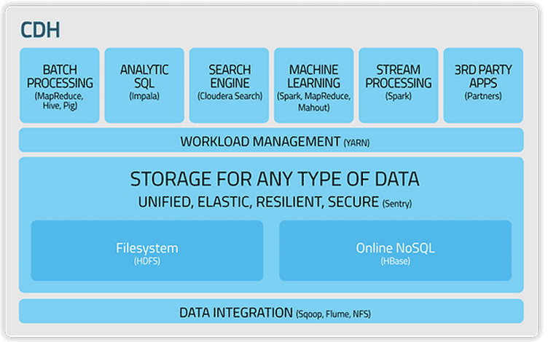
Cloudera Big Data Stack
“CDH Diagram” by Cloudera
(http://www.cloudera.com/content/cloudera/en/products-and-services/cdh.html)

Slide 77
Spark Big Data Stack
Spark SQL
Spark Streaming
MLlib
(Machine
Learning)
GraphX
(Graph Processing)
Spark Core
Standalone Scheduler
YARN
Mesos

Slide 78
Apache Hadoop
The big-data open-source system
Hadoop ecosystem
Hadoop common
HDFS <- distributed file system
YARN <- resource manager
Hadoop MR
YARN/HDFS – basis for many other data processing systems

Slide 79
Design Principles
Moving computation is cheaper than moving data
Failures happen, deal with them
Hide execution details from the user
Take advantage of sequential data access
Use a simple file system coherency model

Slide 80
Resource Manager/YARN

Slide 81
Evolution
YARN, Mesos: support jobs from multiple “data processing” frameworks
Borg: support both latency sensitive jobs and batch jobs

Slide 82
Resource Request Interface
YARN: resource request
Mesos: resource offer
Borg: resource request

Slide 83
Container
Isolate namespaces (file system, process ids)
Kernel-level resource isolation Prevent from interfering each other

Slide 84
Why Container?
Higher resource utilization by sharing machines between applications
Such sharing became possible thanks to container support in the Linux kernel
E.g., colocate latency-critical, user-facing jobs and batch jobs User-facing jobs: reserve more resources than they usually need Mostly-unused resources can be reclaimed to run batch jobs

Slide 85
Modern Container
More than just an isolation mechanism
It also includes an image: the files that make up the application that runs inside the container
E.g., Google MPM (Midas Package Manager) – build and deploy container images

Slide 86
Why Container?
Higher resource utilization by sharing machines between applications
Transforms the datacenter from machine-oriented to application-oriented
Encapsulates the application environment abstracting away many details of machines and operating systems from the application developer and the deployment infrastructure
Well-design containers and container images are scoped to a single application. Managing containers means managing applications rather than machines.
Notes:
Application environment - Originally, cgroup, chroot, namespace - protect applications from noisy and messy neighbors - Combining these with container images -> also isolates applications from the heterogenous operations systems on which they run
This decoupling of image and OS: provide the same deployment environment in both development and production, improves deployment reliability and speeds up development by reducing inconsistencies and friction

Slide 87
The Key to Make This Abstraction Work
Container images that can encapsulate almost all of an application’s dependencies into a package that can be deployed into the container.
If done correctly, only external dependency - Linux kernel system-call interface
At Google, the container has become the sole runnable entity
How to get such images? Program binaries are statically linked at build time to known-good library versions

Slide 88
Containers as the Unit of Management
Not worry about specific details of machines and OSes
Telemetry tied to applications: easy to do application monitoring and introspection
(X) ssh into machines and run top
Logs keyed by applications, not machine
Balance load across application instances
Detect application failures and ascribe failure causes
…

Slide 89
YARN
Hadoop v1 problems
Scalability
Availability
Hard partition of resources into map and reduce slots: low resource utilization
Only MapReduce programming models

Slide 90
YARN
Application
A job submitted to the framework
E.g., MapReduce job
Container
Basic unit of allocation
Fine-grained resource allocation across multiple resource types (memory, CPU, disk, network, etc.)
Locality

Slide 91
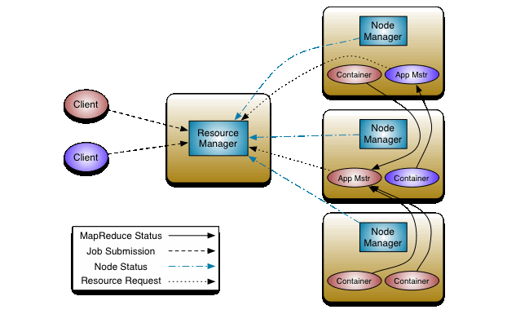
YARN Architecture
“YARN Architecture” by Apache Hadoop
(http://hadoop.apache.org)

Slide 92
YARN Resource Manager, Node Manager, Application Master
Resource Manager
Global resource scheduler
Hierarchical queues
Fair scheduling like Dominant Resource Fairness
Node Manager
Per-machine agent
Manages the life-cycle of container
Container resource monitoring
Application master
Per-application
Manages application scheduling and task execution
E.g., MapReduce Application Master

Slide 93
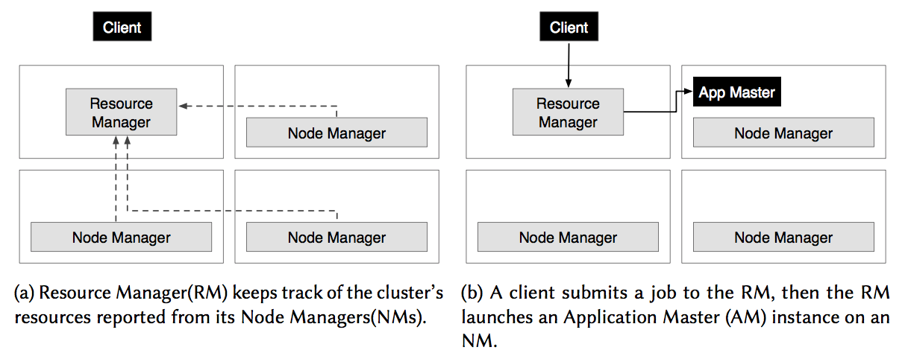

Slide 94
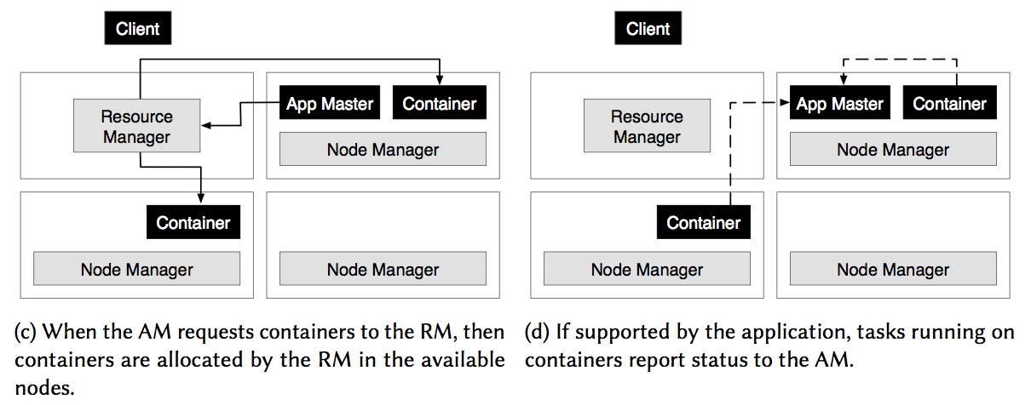

Slide 95
Managing YARN clusters
Prints application(s) report/kill application
yarn application [options] E.g., yarn application –list (lists applications from the RM)
Prints container(s) report
yarn container [options]
Prints node report(s)
yarn node [options]
Prints queue information
yarn queue [options]
Runs a jar file
yarn jar <jar> [mainClass] args...
Start the NodeManager
yarn nodemanager
Start the ResourceManager
yarn resourcemanager

Slide 96
HDFS (Inspired by GFS)

Slide 97
Distributed Storage
Dynamo (2007): 4125 citations – SIGOPS 2017 Hall of Fame Award
GFS (2003): 7321 citations – SIGOPS 2015 Hall of Fame Award
BigTable (2006): 5536 citations – SIGOPS 2016 Hall of Fame Award (Dec. 5. 2017)

Slide 98
Distributed Storage
Dynamo, Cassandra, Voldemort, Espresso, MongoDB, CouchDB, …
GFS, HDFS
BigTable, HBase
Spanner
Haystrack, f4, ..
Distributed file systems – Ficus, Coda, Farsite, …
DHTs – Chord (12998), Pastry (10413), Tapestry, …
Peer-to-peer storage– Oceanstore, Antiquity, PAST, …
Notes:
Bigtable: distributed storage system for managing structured data
A sparse, multi-dimensional sorted map, allows applications access their data using multiple attributes

Slide 99
Why GFS?
Node failures happen frequently
Files are huge – multi-GB
Most files are modified by appending at the end
Random writes (and overwrites) are practically non-existent
High sustained bandwidth is more important than low latency
Place more priority on processing data in bulk

Slide 100

Typical workloads on GFS
Two kinds of reads: large streaming reads & small random reads
Large streaming reads usually read 1MB or more
Oftentimes, applications read through contiguous regions in the file
Small random reads are usually only a few KBs at some arbitrary offset
Also many large, sequential writes that append data to files
Similar operation sizes to reads
Once written, files are seldom modified again
Small writes at arbitrary offsets do not have to be efficient
Multiple clients (e.g. ~100) concurrently appending to a single file
e.g. producer-consumer queues, many-way merging

Slide 101
Interface
Not POSIX-compliant, but supports typical file system operations: create, delete, open, close, read, and write
snapshot: creates a copy of a file or a directory tree at low cost
record append: allow multiple clients to append data to the same file concurrently
At least the very first append is guaranteed to be atomic

Slide 102
HDFS
Inspired by GFS
FileSystem interface
File, directory operations
FileSystem organization
Big block size (e.g., 128MB)
Reads, append-only writes
K-way replication (default K=3)
Optimized for high throughput and fault tolerance
Master-slave architecture

Slide 103

HDFS Architecture
“HDFS Architecture” by Apache Hadoop
(http://hadoop.apache.org)

Slide 104
HDFS Architecture
Data flow is decoupled from control flow
Clients interact with the namenode for metadata operations
Clients interact directly with datanodes for all files operations
This means performance can be improved by scheduling expensive data flow based on the network topology

Slide 105
NameNode
One “primary” name node per cluster
Stores meta information of the file system such as file name, permission, directories, and block locations
Keep meta information in RAM for fast access and make it persistent to disk
Secondary name node for backup
Name node high availability

Slide 106
DataNode
Many slave nodes in the cluster
Stores individual file blocks but knows nothing about them
Reports heartbeats to NameNode

Slide 107
HDFS commands
Gets help
hadoop fs -help
Create a directory
hadoop fs –mkdir <path>
Path: uri
Local file system directory: e.g., /user/hadoop/dir1
HDFS directory: e.g., hdfs://nn1.example.com/user/hadoop/dir
Lists the contents of a directory
hadoop fs –ls <path>
hadoop fs –lsr <path>

Slide 108
HDFS commands
Upload files from the local file system to HDFS
hadoop fs –put <localsrc> … <HDFS destination path>
Download files from HDFS to the local file system
hadoop fs –get <hdfs source> <local destination>
Move files that match the pattern <src> to <dst>
hadoop fs –mv <src> <dst>
Copy files that match the pattern <src> to <dst>
hadoop fs –cp <src> <dst>
Delete all files that match the pattern <src>
hadoop fs –rm <src>

Slide 109
HDFS commands
Fetch all files that match the pattern defined by <src>
Hadoop fs –cat <src>
…
Copy file or directories recursively (used for large inter/intra-cluster copying)
hadoop distcp <source url> <destination url>

Slide 110
HBase (Inspired by BigTable)

Slide 111
Data Store: NoSQL
NoSQL on top of DFS
Key-value store
Distributed hash table: put, get
E.g., Cassandra
Bigtable style
A sparse set of rows
E.g., HBase

Slide 112
HBase
A distributed storage system for structured data
Target workloads: both throughput-oriented batch processing jobs and latency-sensitive serving of data to end users
A simple data model that supports dynamic control over data layout and format and allows clients to reason about the locality of data
It does not support a full relational data model
Control locality through schema choices
Serve data out of memory or from disk; control through schema parameters
HBase supports HDFS out of the box as its distributed file system.

Slide 113
HDFS vs HBase
HDFS: a distributed file system that is well suited for the storage of large files
HBase: built on top of HDFS and provides fast record lookups (and updates) for large tables.
puts your data in indexed "StoreFiles" that exist on HDFS for high-speed lookups.

Slide 114
Data Model
Applications store data into an HBase table
Tables are made of rows and columns
All columns in HBase belong to a particular column family
Table cells -- the intersection of row and column coordinates -- are versioned
A cell’s content is an uninterpreted array of bytes

Slide 115
Data Model
Table row keys are also byte arrays so almost anything can serve as a row key from strings to binary representations of longs or even serialized data structures
Rows in HBase tables are sorted by row key
The sort is byte-ordered
All table accesses are via the table row key -- its primary key

Slide 116
Data Model (In Another Way to Look At)
Sparse, distributed, persistent multi-dimensional sorted map
Indexed by a row key, column key, and a timestamp
Each value: uninterpreted array of bytes (row: string, column:string, time:int64) -> string

Slide 117
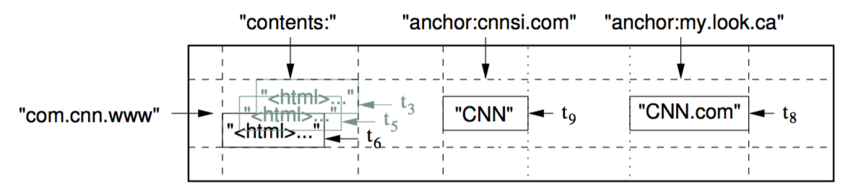
Data Model
Rows: per-row atomic read/write, maintains data in lexicographic order by row key
Column families: unit of access control, memory/disk accounting, usually same data type (compressed)
Column key - family:qualifier (e.g., anchor:cnnsi.com)
Timestamps: each cell can contain multiple versions of same data
Notes:
Qualifier: name of the referring site
The cell contents is the link text
the colon character (:) delimits the column family from the column family qualifier.

Slide 118
Data Model Operations
Get returns attributes for a specified row.
Put either adds new rows to a table (if the key is new) or can update existing rows (if the key already exists).
Scan allow iteration over multiple rows for specified attributes.
Delete removes a row from a table.
HBase does not modify data in place, and so deletes are handled by creating new markers called tombstones. These tombstones, along with the dead values, are cleaned up on major compactions.

